Slide 1


NPOI Capstone: Prototype Demo
Bradley Kingsley
Dustin Haines
Son Nguyen

Slide 2
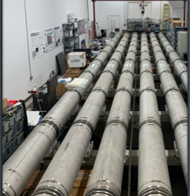
Project Description
Main purpose of NPOI:
  Astronomical observation and a better understanding of how the universe works
Optical Interferometry:
  Multiple telescopes collect light to be sent to the lab
Our Project:
  Designing seal plates for both ends of the Fast Delay Lines (FDL's) that are light and easy to remove, along with snoot layout optimization
It took three of us 5 hours to disassemble and it reassemble 1 front of tank, without maintenance

Slide 3
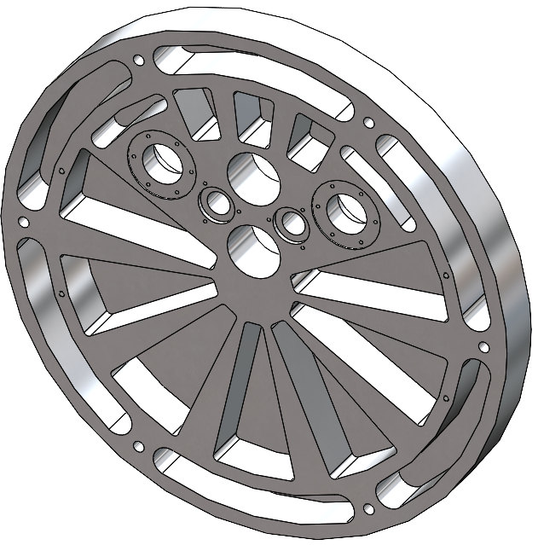
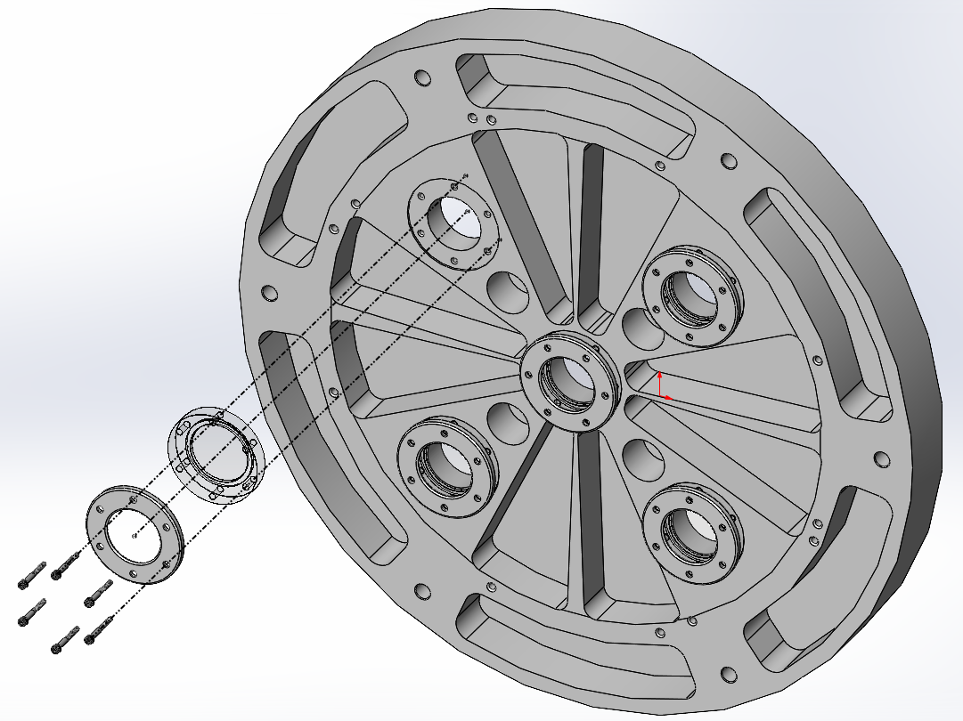
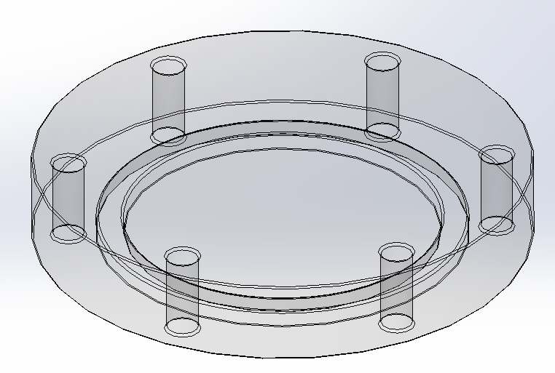
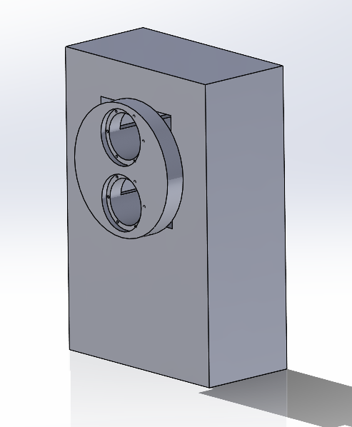
Current State of Model
Window Assembly
Seal Plates
  Provide a seal under pressure with little deformation that allows for inside viewing
Snoot Alignment
  Provide a new stand that can withstand vacuum force.
  Keep the snoot in place during vacuum operation and standby.
Front End Flange Cover
FDL Back Plate (Lightweight)
Vacuum Window Polycarbonate
Snoot Adjusting Fixture

Slide 4
CN's vs ER's
Lightweight
User/Technician Friendly
Seal to Vacuum
Stable Alignment
Small Deformation
Adjustable Frame
Sight Ports
Less Than 35 lbs.
Disassembly < 1 Hour
Seals tanks in ATM and in Vacuum (Torr)
Drift < 0.001 in/month
Deformation < 0.010 in
X,Y, adjustment ±0.5 in
At least 2 sight Ports

Slide 5
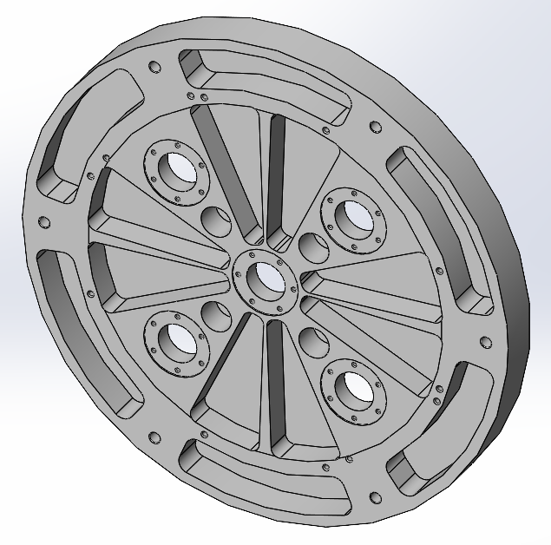
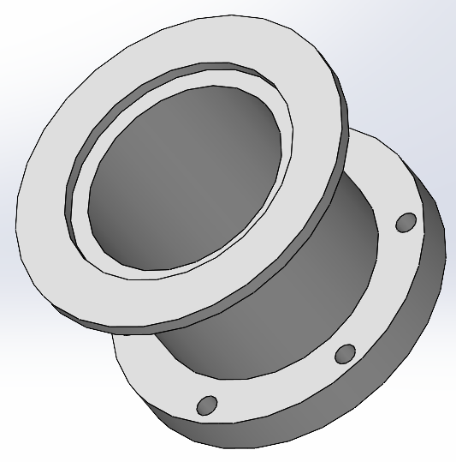
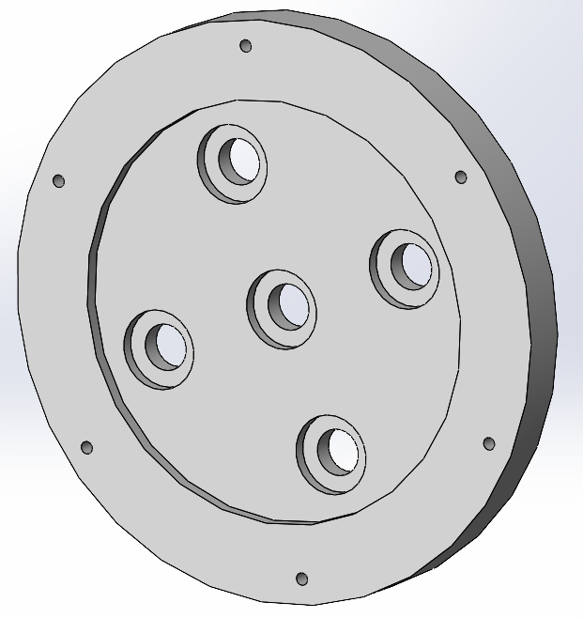
Prototype 1 – Rear Seal Plate
Pertinent CN's:
  Lightweight
  User/Technician Friendly
  Seal to Vacuum
  Small Deformation
  Sight Ports

Slide 6
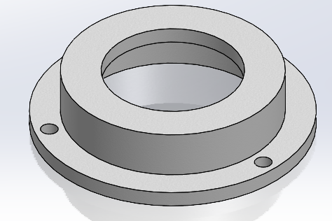
Prototype 2 – Front Seal Plate
Pertinent CN's:
  Lightweight
  User/Technician Friendly
  Seal to Vacuum
  Small Deformation
  Sight Ports

Slide 7
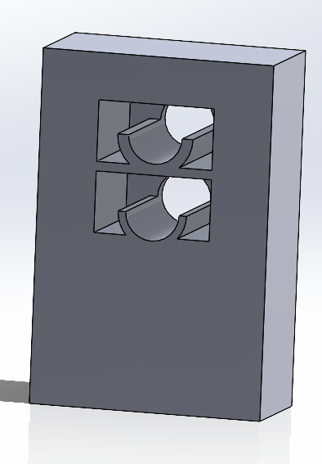
Prototype 3 – Snoot Fixture/Adjuster
Pertinent CN's:
  User/Technician Friendly
  Adjustable Frame
  Stable Alignment

Slide 8
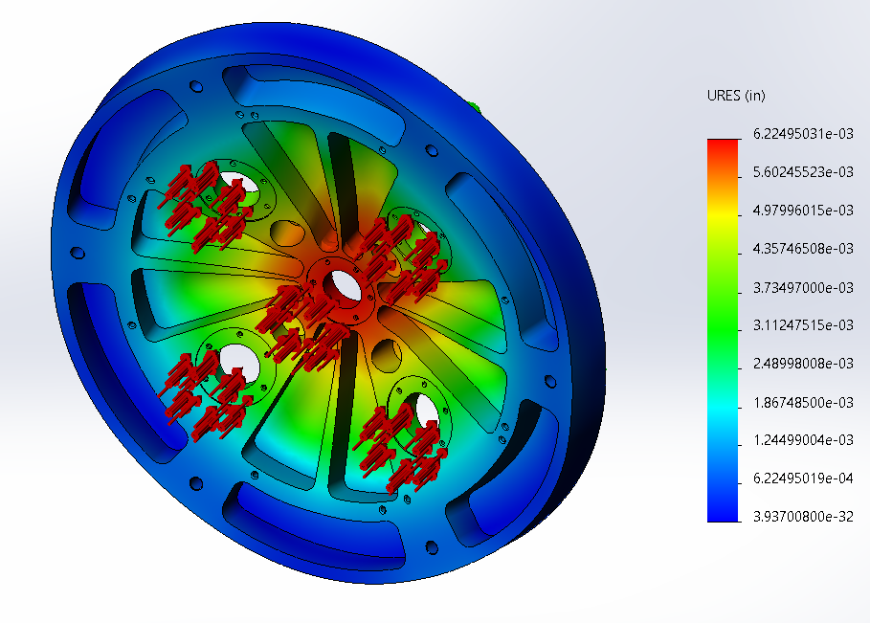
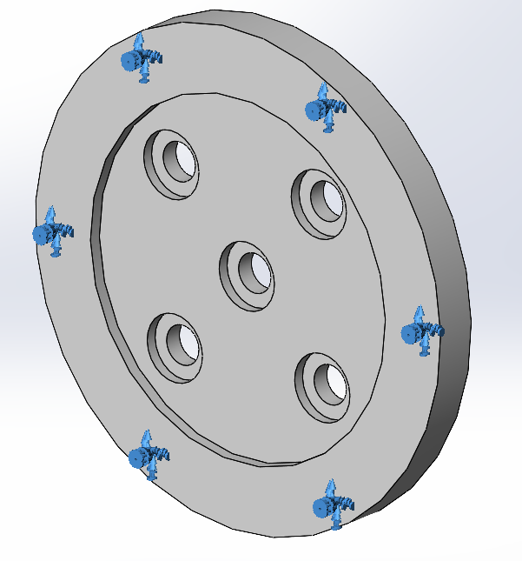
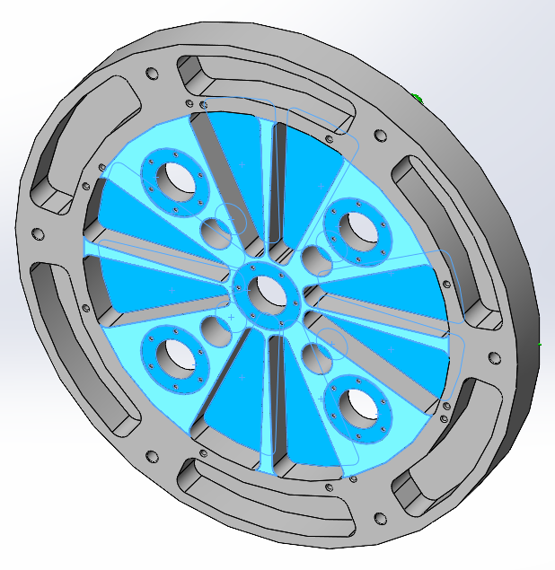
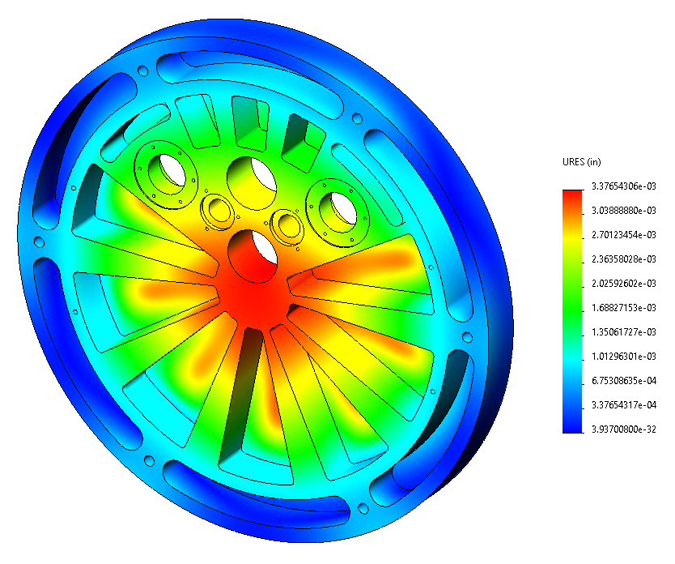
Design Validation
Potential critical failures:
  Breaking Vacuum (O-ring not sealing)
  Greater deformation than allowed
  Stress concentration in sharp corners
  Material stability
Testing Procedures:
  SolidWorks simulation
  ANSYS simulation
  Back-of-the-hand calculations
  Textbooks (provided by client)

Slide 9
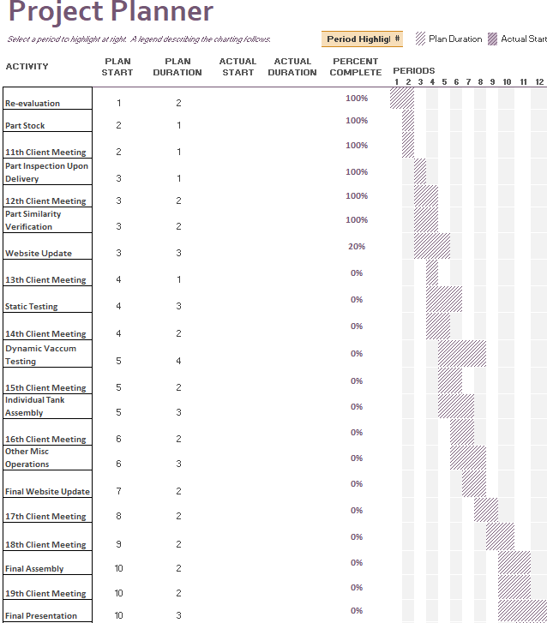
Schedule
As of this presentation, we are on schedule.

Slide 10
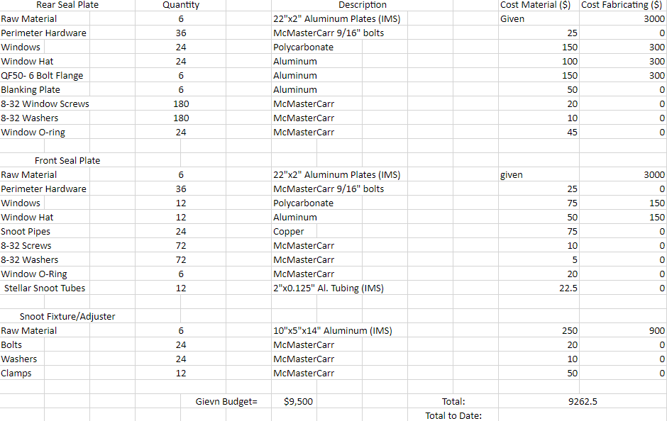
Budget
BOM

Slide 11
References:
[1] 'The Importance of Choosing the Correct Material for Vacuum O-Rings and Vacuum Seals'. Apple Rubber. [OnlineAccess]. https://www.applerubber.com/hot-topics-for-engineers/the-importance-of-the-correct-material-for-vacuum-o-rings-and-vacuum-seals/​
[2] J.A. Clark III , J. Murphy, L. Ha, J. P. Walton , J. Howard, J. T. Armstrong, G. C. Gilbreath , R. B. Hindsley , and T. A. Pauls. 'Alignment of vacuum feed stations on the Navy Prototype Optical Interferometer'. [OnlineAccess]. https://apps.dtic.mil/sti/pdfs/ADA477246.pdf​
[3] 'Vacuum Chambers and Optical Equipment'. Imperial Machine & Tool CO. [OnlineAccess]. https://www.imperialmachine.com/vacuum-chambers​
[4] 'The long-stroke MROI vacuum delay lines from concept to generation' [OnlineAccess]. https://www.researchgate.net/publication/237371110_The_long-stroke_MROI_vacuum_delay_lines_from_concept_to_production​
[5] “Kurt J. Lesker Company,” www.lesker.com. https://www.lesker.com/index.cfm (accessed Oct. 11, 2022).​
[6] “Parker Engineering Your Success Motion Control Technology,” Parker Hannifin Corporation, 2020. https://www.parker.com/portal/site/PARKER/menuitem.b90576e27a4d71ae1bfcc510237ad1ca/?vgnextoid=c38888b5bd16e010VgnVCM1000000308a8c0RCRD&vgnextfmt=EN​
[7] “Fittings, Flanges, and Hardware | Ideal Vacuum,” www.idealvac.com. https://www.idealvac.com/Fittings-and-Flanges/ct/2 (accessed Oct. 11, 2022). ​
[8] “Vacuum Fittings and Flanges,” www.newport.com. https://www.newport.com/c/vacuum-flange-components (accessed Oct. 11, 2022).​
[9] “Optical Imaging | Laser Optics | Edmund Optics,” www.edmundoptics.com. https://www.edmundoptics.com/​
[10] “Carr,” McMaster. [Online]. Available: https://www.mcmaster.com/. [Accessed: 11-Oct-2022]. ​
[11] “Thorlabs, Inc. - your source for fiber optics, laser diodes, optical instrumentation and polarization measurement & control,” Thorlabs, Inc. - Your Source for Fiber Optics, Laser Diodes, Optical Instrumentation and Polarization Measurement & Control. [Online]. Available: https://www.thorlabs.com/. [Accessed: 11-Oct-2022]. ​
[12] “Aluminum supplier,” Aluminum Supplier | Bar, Sheet, Plate, Tube, Pipe, Shape. [Online]. Available: https://www.industrialmetalsupply.com/Products/Metals/aluminum?gclid=EAIaIQobChMIp7f_rKrZgIV9QetBh3t0QAOEAAYASAAEgKFvPD_BwE. [Accessed: 11-Oct-2022]. ​
[13] “Home,” Alaska Rubber Group. [Online]. Available: https://www.alaskarubbergroup.com/. [Accessed: 11-Oct-2022]. ​
[14] Www.htcvacuum.com 日揚科技股份有限公司 |, “Vacuum components suppliers: Vacuum products manufacturer: Vacuum Chamber Kits - HTC Vacuum,” Vacuum Components Suppliers| Vacuum Products Manufacturer | Vacuum Chamber kits - Htc vacuum. [Online]. Available: https://www.htcvacuum.com/en-global/vacuum-components?gclid=EAIaIQobChMIrKbp4arZ-gIV-BetBh3FDAJXEAAYASAAEgKxi_D_BwE. [Accessed: 11-Oct-2022]. ​
[15] “Socket Head Cap Screws Dimensions & Specs | AFT Fasteners,” www.aftfasteners.com. https://www.aftfasteners.com/socket-cap-screws-dimensions-and-mechanical-properties/ (accessed Oct. 11, 2022).​

